Slide 1

Auto Insurance Fraud Prediction
ALY 6015: Intermediate Analytics
Name : Ankit Bhalekar
&
LAZAREE WORLIKAR

Slide 2
Introduction
Auto insurance fraud involves deliberate deception or manipulation of insurance claims
Purpose: Detecting and preventing fraudulent activities for insurers
Importance: Maintain profitability and ensure fair practices
Auto insurance fraud detection dataset: kaggle
Use: Developing predictive models and algorithms such as logistic regression and random forest
Goal: Accurately identify fraudulent claims

Slide 3
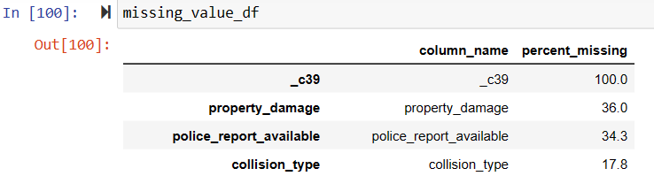
Dataset EDA
Our dataset had 1000 rows and 40 variables such as age, policy number, policy state, umbrella limit, fraud etc.
Our dependent variable fraud is imbalanced with 75.5% non frauds and only 24.5 % frauds.
We had missing values in the 4 columns out of which _c39 had 100 % missing values since we decided to drop that column.

Slide 4
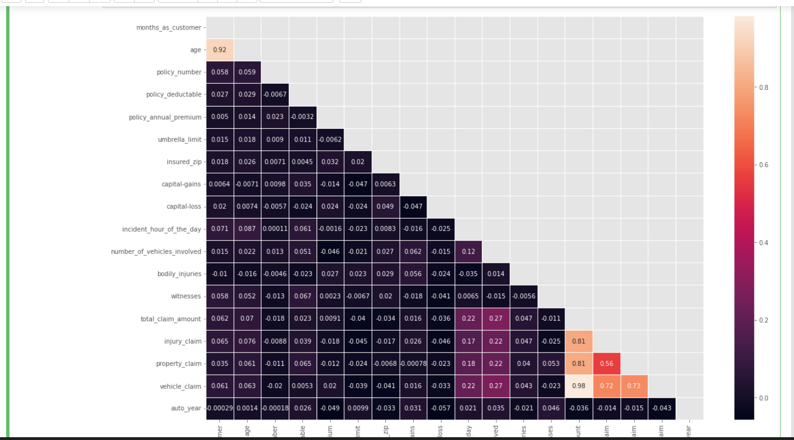
x
Age and months_as_customer are highly correlated
We will eliminate the "Age" column
Total_claim_amount, injury_claim, property_claim, and vehicle_claim are strongly associated
Total_claim_amount equals the sum of all other claims
We will remove the total_claim_amount column

Slide 5
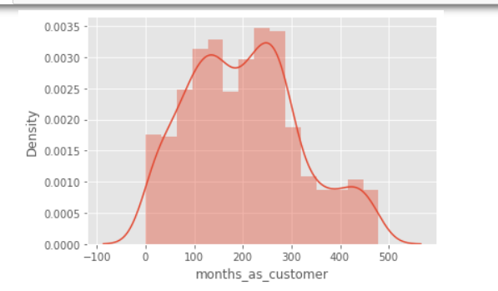
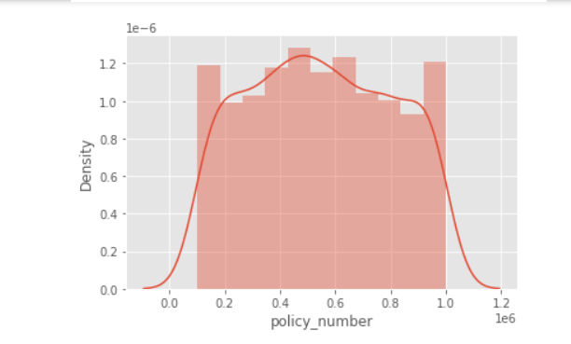
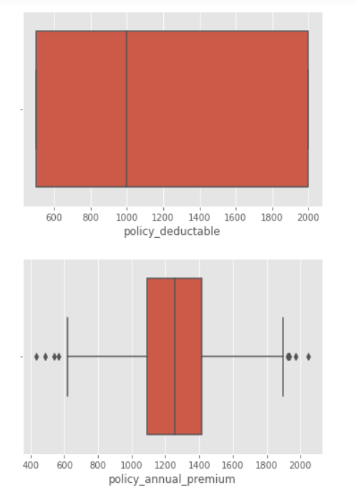
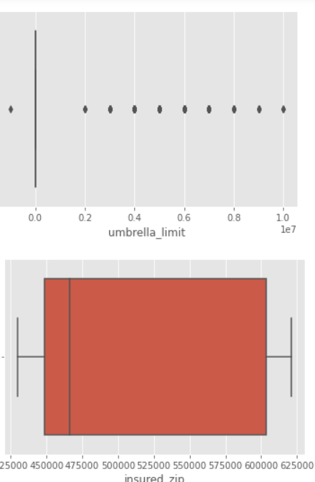
Distribution of some of variables can be seen below:
Outliers are present in some numerical columns we will scale numerical columns:

Slide 6
Baseline Accuracy:
As our dataset is imbalance, accuracy is not a good measure of success. A high accuracy can be achieved by a poor model that only selects the majority class, hence, not detecting and measuring the accuracy of classifying the class of interest. In fact, predicting only the majority class will give an accuracy of 75%, specificity of 100% but a sensitivity of 0%.
As identifying as many frauds as possible is the goal, however investigations into frauds can be time consuming and expensive and may even
affect customer experience.
Hence,we will try to obtain a good sensitivity with reasonable accuracy and specificity.

Slide 7
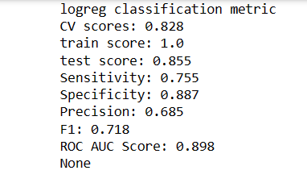
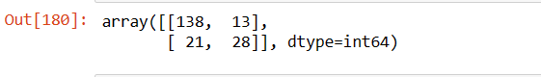
Method 1: Logistic Regression Auto insurance fraud detection typically involves a binary classification problem, where the goal is to predict whether a claim is fraudulent or not. Logistic regression is a widely used algorithm for binary classification tasks as it models the probability of the target variable belonging to a specific class. Sensitivity is 75.5%, which measures the proportion of correctly identified fraudulent claims in a fraud detection model for auto insurance. Specificity is 88.7% in this model, which measures the proportion of correctly identified non-fraudulent claims. Precision is 68.5%, which measures the proportion of predicted fraudulent claims that are actually true positives. The F1 score is 71.8%, which combines precision and sensitivity, providing an overall assessment of the model's performance. The ROC AUC score is 89.8%, indicating good discriminative ability in distinguishing between fraudulent and non-fraudulent claims. These evaluation metrics suggest that the model performs reasonably well, but further consideration of specific requirements is necessary.

Slide 8
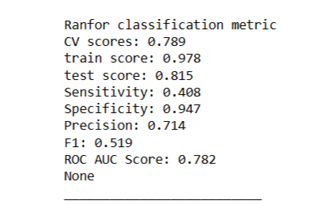
Method 2: Random Forest
Auto insurance fraud detection typically involves large datasets with numerous features. Random Forest can handle high-dimensional data efficiently, making it suitable for such tasks.
Cross-validation score (CV) of 0.789 suggests reasonable performance on average
Training data accuracy is high at 0.978, while test data accuracy is slightly lower at 0.815
Sensitivity (recall) is 0.408, indicating a relatively low ability to identify fraudulent cases
Specificity is high at 0.947, indicating a good ability to identify non-fraudulent cases
Precision is 0.714, meaning the model is correct around 71.4% of the time when predicting fraud
F1 score is 0.519, suggesting a moderate overall performance considering both precision and sensitivity
ROC AUC score is 0.782, indicating reasonable discrimination between positive and negative cases

Slide 9
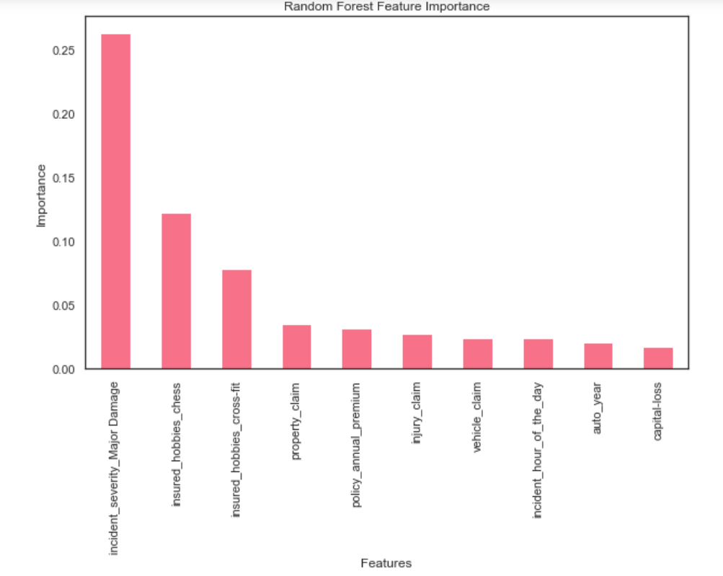
Feature Importance(Top 10)
Incident_severity_major_damage explains more than 25% variability for the target variable fraud followed by insured hobbies chess.
Incide

Slide 10
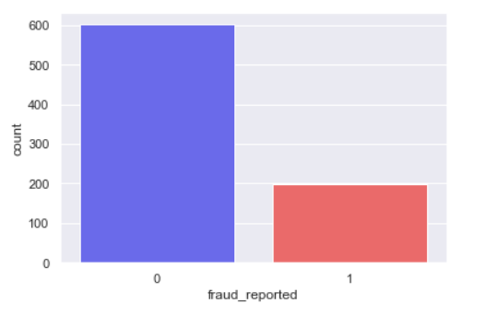
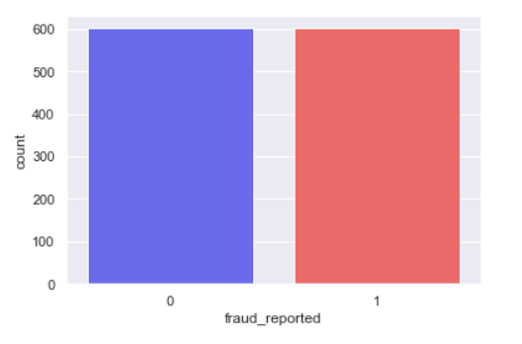

SMOTE
SMOTE (Synthetic Minority Over-sampling Technique) is a popular method used to address the issue of class imbalance in machine learning datasets.
Class imbalance can lead to biased models that predominantly predict the majority class.
By oversampling the minority class using SMOTE, the dataset becomes more balanced, ensuring that the model receives sufficient examples of the minority class to learn from. This can improve the model's ability to recognize and predict minority class instances accurately.
Before SMOTE After SMOTE

Slide 11
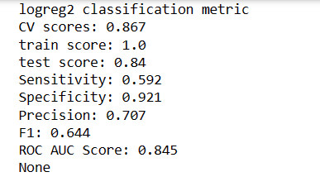
Method3: Logistic Regression With SMOTE Cross-validation score: 0.867 - The auto insurance fraud detection model performs well on multiple subsets of data, indicating its generalization ability. Sensitivity: 59.2% - The model successfully captures approximately 59.2% of true fraud cases, indicating its ability to identify fraudulent instances. Specificity: 92.1% - The model accurately classifies 92.1% of non-fraud cases, demonstrating its ability to recognize legitimate instances. Precision: 0.707 - Around 70.7% of the predicted fraud cases by the model are genuine, indicating its reliability in identifying actual fraudulent cases. F1 score: 0.644 - The F1 score provides a reasonable balance between precision and sensitivity, suggesting that the model has a fair trade-off between correctly identifying fraud cases and minimizing false positives. ROC AUC score: 0.845 - The model exhibits good discriminatory ability in distinguishing between fraud and non-fraud cases, as indicated by the ROC AUC score.

Slide 12
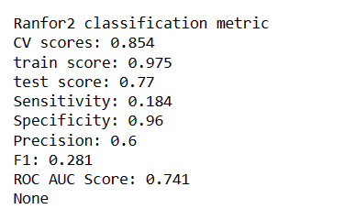
Method4 : Random Forest with SMOTE Sensitivity: 0.184 The model correctly identified only 18.4% of the actual fraud cases, indicating a low sensitivity. Specificity: 0.96 The model accurately identified 96% of the non-fraudulent cases, indicating a high specificity. Precision: 0.6 60% of the predicted fraud cases were actually fraudulent, representing the precision of the model. F1 score: 0.281 The F1 score, which balances precision and sensitivity, was 0.281, suggesting a trade-off between the two. ROC AUC score: 0.741 The model achieved a moderate level of discrimination between positive (fraud) and negative (non-fraud) cases, as indicated by the ROC AUC score.

Slide 13
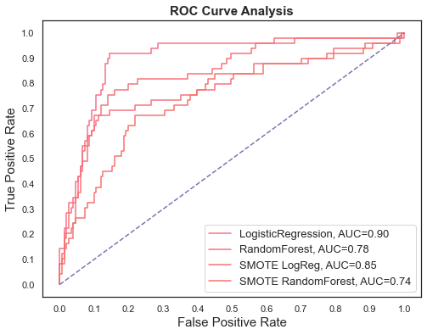
Comparison of our models
The ROC curve is a graphical representation of the performance of a binary classification model at various classification thresholds. It shows the trade-off between the true positive rate (TPR) and the false positive rate (FPR) for different threshold values
In summary, based on the AUC values, the logistic regression model performed the best (AUC=0.90), followed by the SMOTE logistic regression model (AUC=0.85). The random forest models, both with and without SMOTE, had lower AUC values (0.78 and 0.74, respectively), suggesting slightly lower performance in this particular context of auto insurance fraud detection.

Slide 14
Conclusion:
Auto insurance fraud involves deliberate deception or manipulation of insurance claims to obtain financial benefits fraudulently. Detecting and preventing such fraudulent activities is essential for insurers to maintain their profitability and ensure fair practices.
Logistic regression is having good accuracy as compared to other models. Despite of adding smote, model did not show much improvement.
Incident severity major damage explains more than 25% variability for the target variable fraud

Slide 15

Acknowledgement
We would like to take this opportunity to express our heartfelt gratitude and appreciation to the professor, teaching assistant, and my wonderful classmates who have been instrumental in my academic journey. Their unwavering support, guidance, and encouragement have been invaluable to our growth and development.
First and foremost, we extend our deepest thanks to Professor Amin Karimpour. Your extensive knowledge, dedication to teaching, and passion for the subject matter have inspired us greatly. Your thought-provoking lectures and insightful discussions have broadened our horizons and enhanced our understanding of the subject.
We would also like to express our sincere appreciation to Xiangyu Zhang, our exceptional teaching assistant. Your patience, approachability, and willingness to go the extra mile to assist us have been remarkable.
Furthermore, we would like to extend our gratitude to our fellow classmates. Your active participation in class discussions, collaborative projects, and study groups has enriched our learning experience.

